Slide 1
Stroke

Slide 2
Stroke
What is it?
What causes it?
What happens after a stroke?
How can we diagnose?
How can we treat?
How can we prevent?

Slide 3
Stroke - What is it?

Slide 4
Stroke - What is it?
sudden
disturbance of brain function

Slide 5
Stroke - What is it?
sudden
disturbance of brain function - focal or global

Slide 6
Stroke - What is it?
sudden
disturbance of brain function - focal or global
due to a disturbance in its blood supply

Slide 7
Stroke is a Brain Attack!

Slide 8
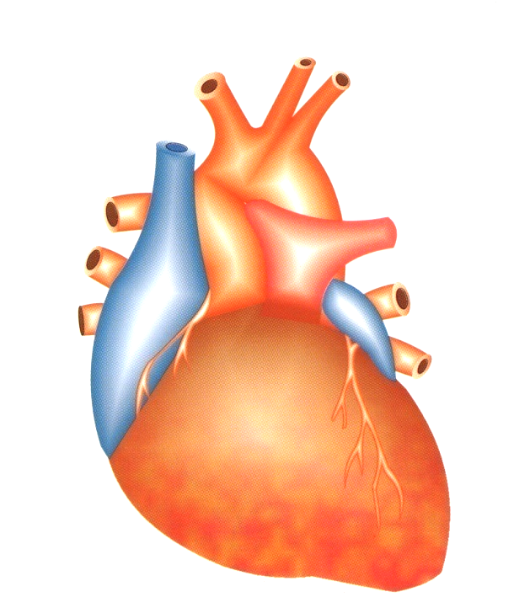
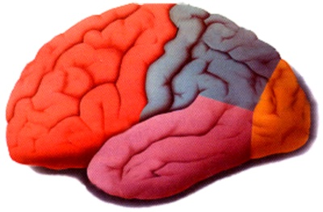
Stroke is a Brain Attack!
Heart Attack
Brain Attack

Slide 9
Stroke
What is it?
What causes it?
What happens after a stroke?
How can we diagnose?
How can we treat?
How can we prevent?

Slide 10
Stroke - What causes it?

Slide 11
Stroke - What causes it?
sudden disturbance of brain function
due to a disturbance in its blood supply
    interruption to blood flow - ischaemic stroke / infarct
    rupture of blood vessel - haemorrhage

Slide 12
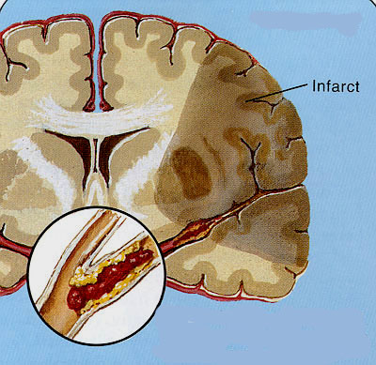
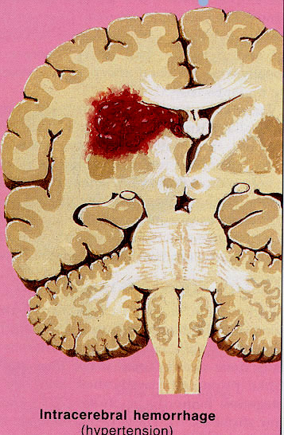
ischaemic stroke
infarct
haemorrhagic stroke

Slide 13
Stroke - What causes it?
ischaemic 80%
intracerebral haemorrhage 15%
subarachnoid haemorrhage 5%

Slide 14
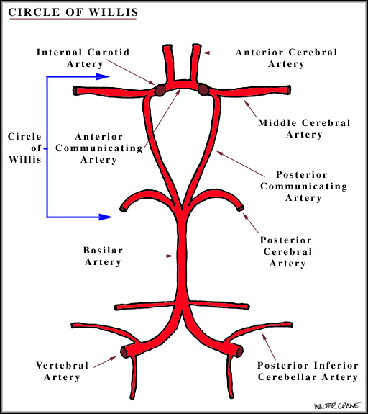
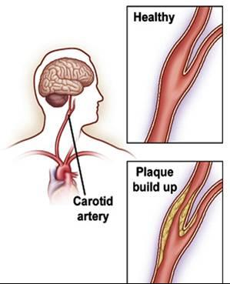
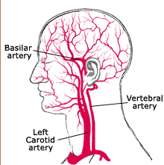
Ischaemic Stroke - What causes it?
anterior circulation – carotid
posterior circulation – vertebro-basilar

Slide 15
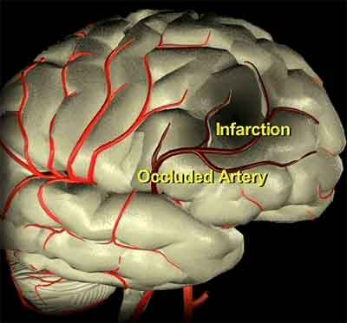
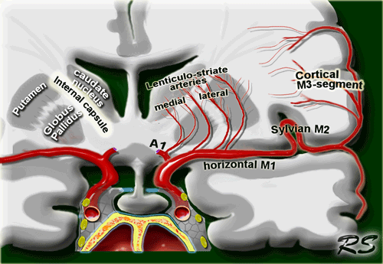
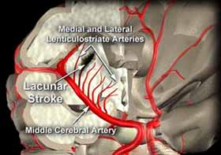
large artery disease
small artery disease – lacunar stroke

Slide 16
Ischaemic Stroke - What causes it?
large artery atherosclerosis
small artery disease
cardiogenic embolism
      AF, post-MI, LV clots, valvular dis, …
other – blood, blood vessels, …
      hypercoagulable states, vasculitis, …

Slide 17
Stroke - the Ischaemic Cascade

Slide 18
Stroke - the Ischaemic Cascade
substrate delivery (O_{2 ,} glucose) impaired
energy production falls
↓
anaerobic glycolysis, lactic acidosis
ionic pump failure
neuronal depolarisation, oedema
Ca²⁺ floods in
excitatory neurotransmitter release
inflammatory mediators
↓
damage to cell structures
neuronal death

Slide 19
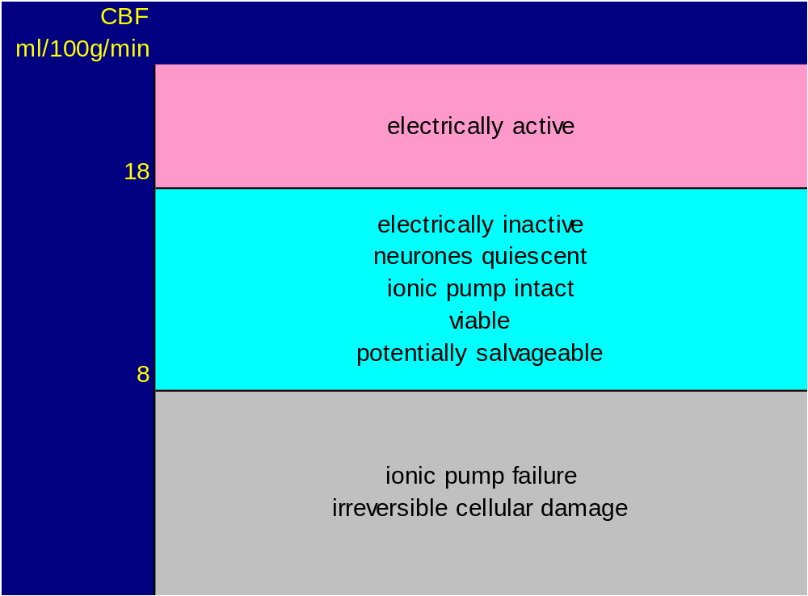

Slide 20
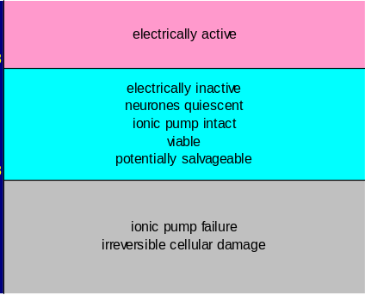
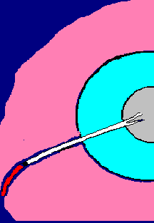

Slide 21
Ischaemic penumbra
compromised
salvageable
therapeutic window
of opportunity

Slide 22
Risk factors for stroke

Slide 23
Risk factors for stroke
Non- modifiable
age
sex
past history
family history

Slide 24
Risk factors for stroke
Modifiable
Disease-related Life style
hypertension smoking
heart disease alcohol excess
diabetes physical inactivity
hyperlipidaemia diet
carotid stenosis obesity
other ….

Slide 25
Stroke
What is it?
What causes it?
What happens after a stroke?
How can we diagnose?
How can we treat?
How can we prevent?

Slide 26
What happens after a stroke?

Slide 27
What happens after a stroke?
disturbance of brain function

Slide 28
What happens after a stroke?
disturbance of brain function
  movement - paralysis
  sensation
  speech - expression, understanding
  vision
  giddiness, vertigo, vomiting, headache
  consciousness
  sudden death

Slide 29
What happens after a stroke?
sudden disturbance of brain function
due to a disturbance in its blood supply
anterior circulation – carotid territory
posterior circulation – vertebro-basilar territory
lacunar stroke

Slide 30
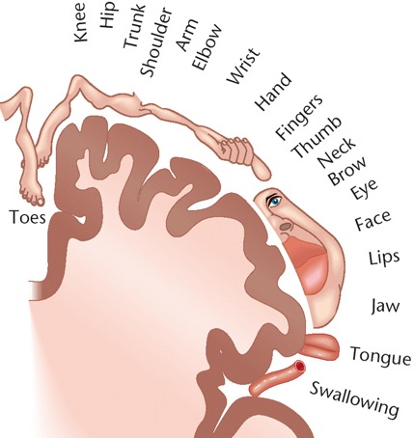
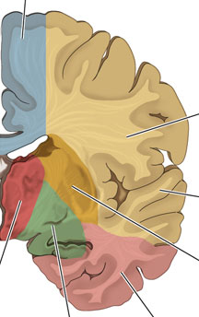
ACA
MCA
MCA stroke – arm weakness > leg
ACA stroke – leg weakness > arm

Slide 31
stroke - symptoms last > 24 hours
if symptoms last < 24 hours -
transient ischaemic attack (TIA)
‘mini-stroke’
warning signal - need medical attention

Slide 32
Stroke
What is it?
What causes it?
What happens after a stroke?
How can we diagnose?
How can we treat?
How can we prevent?

Slide 33
How can we diagnose a stroke?

Slide 34
How can we diagnose a stroke?
Emergency evaluation
Stroke diagnosis is CLINICAL.
CT
MRI

Slide 35
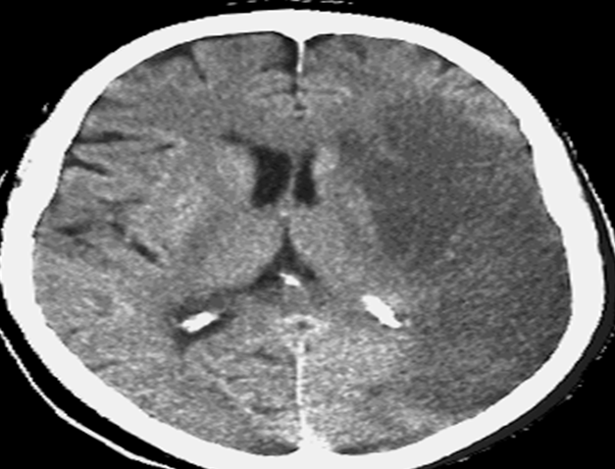
ischaemic stroke
infarct

Slide 36
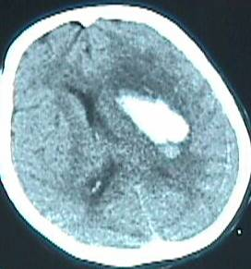
haemorrhagic stroke

Slide 37
Stroke
What is it?
What causes it?
What happens after a stroke?
How can we diagnose?
How can we treat?
How can we prevent?

Slide 38
How can we treat a stroke?

Slide 39
How can we treat a stroke?
Emergency evaluation - clinical + CT
Acute management - general care
specific treatment - thrombolysis
Stroke Unit care
Early secondary prevention / rehabilitation

Slide 40
Acute management - General care

Slide 41
Acute management - General care
  ABC
  fluids blood pressure temperature glucose
  nutrition, swallowing, bladder, bowel
  reduce brain oedema

Slide 42
Acute Management - Blood Pressure

Slide 43
Acute Management - Blood Pressure
early rise in BP common - up to 80%
maintains perfusion to penumbra
spontaneous resolution - 2/3 at 7-10 d
loss of auto regulation
BP fall - aggravate ischaemia in penumbra
early anti hypertensive therapy
extension of infarct
increased mortality

Slide 44
Acute Management - Blood Pressure ...
treat after 7-10 days
treat early only if
pre-existing hypertension
SBP > 220, DBP > 120
hypetensive emergency -
MI, LVF, aortic dissection, encephalopathy

Slide 45
Acute Management - Fluids
fluids - oral/ NG tube / iv 0.9% saline
avoid iv glucose
avoid hypovolaemia
dehydration → haemoconcentration
→ impede blood flow in penumbra
avoid hypervolaemia
aggravate cerebral oedema

Slide 46
Acute Management - Brain oedema
avoid hypervolaemia
avoid hyperglycaemia
iv mannitol, glycerol
steroids - no place

Slide 47
Acute Management - Thrombolysis

Slide 48
Ischaemic penumbra
compromised
salvageable
therapeutic window
of opportunity

Slide 49
Acute Management - Thrombolysis
only for ischaemic stroke
streptokinase - no benefit
rt-PA - within 6h
improved outcomes

Slide 50
Acute Management - Aspirin
early use of aspirin – within 48h
→ small, significant benefits
in early outcomes
heparin - no value

Slide 51
Stroke Unit

Slide 52
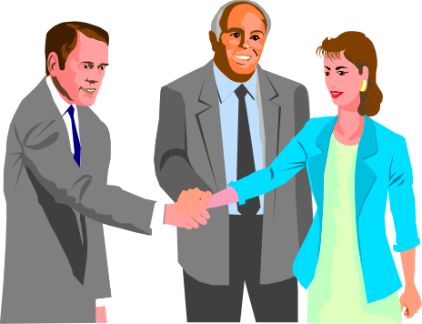
Stroke Unit
multi-disciplinary stroke team
  doctors, nurses
  therapists – physio, occupational, speech
  mental health workers
  social workers
organised in-patient care
defined area
not a stroke intensive care unit

Slide 53
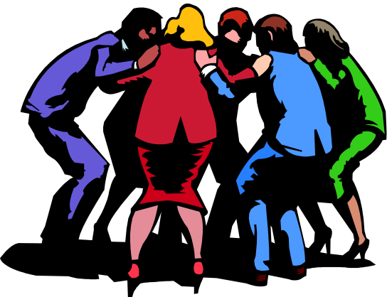
Rehabilitation
  restoration of patients to previous
physical, mental and social capacity
team approach
active participation -
  patients, care givers

Slide 54
Stroke
What is it?
What causes it?
What happens after a stroke?
How can we diagnose?
How can we treat?
How can we prevent?

Slide 55
Stroke Prevention
Primary
prevent first stroke
Secondary
prevent recurrences after a stroke

Slide 56
How can we prevent a stroke?

Slide 57
How can we prevent a stroke?
Life style modification
Management of risk factors
Drugs to prevent strokes

Slide 58
How can we prevent a stroke?
Life style modification
diet
physical activity
ideal weight
smoking
alcohol

Slide 59
How can we prevent a stroke?
Modification of risk factors
high blood pressure
heart disease
diabetes
high cholesterol
surgery for carotid stenosis

Slide 60
How can we prevent a stroke?
Drugs to prevent strokes
  anti-platelet agents
aspirin
dipyridamole, clopidogrel
  anticoagulants - warfarin
        for cardio-embolic stroke

Slide 61
Haemorrhagic stroke

Slide 62
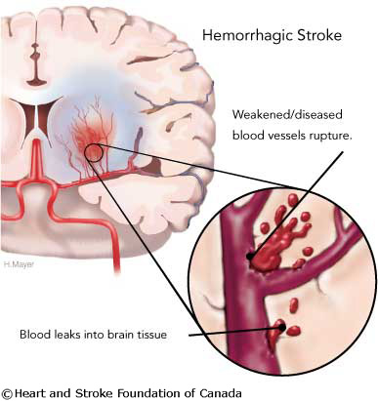
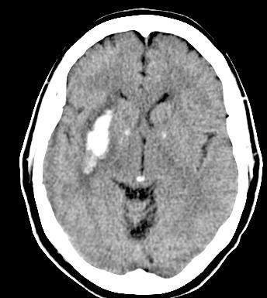
usually deep, basal ganglia
hypertension related small vessel disease

Slide 63
Managing haemorrhagic stroke
  ICH - high mortality - 50% at 1y
  1/3rd - early deterioration related to haematoma growth
  no specific medical treatment

Slide 64
Managing haemorrhagic stroke
general care
Stroke unit care
surgery - benefits unclear except for
    large cerebellar haematomas
    large lobar haemorrhages with deterioration
recombinant factor VIIa - no proven efficacy

Slide 65
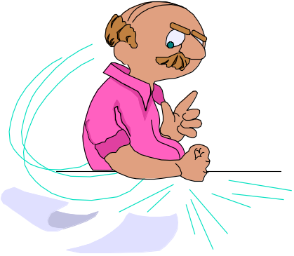
Remember!
Stroke is an emergency - a Brain Attack!
Stroke can be treated
Early treatment would improve outcome
Stroke can be prevented

Slide 66
Remember!
Stroke is VERY EASY!

